Slide 1
TITLE
Distributed Operating System in a Multi-Location Company
Course Name: Operating Systems
Course Code: CSA04
Student Name: M. VENKATESH
Register Number: 192511133

Slide 2
Introduction
A distributed system connects computers at different locations.
Computers communicate through a network.
Resources such as files, applications, and storage can be shared.
It supports communication and collaboration between company branches.
It allows multiple users to access shared resources simultaneously.
It improves resource utilization and system performance.

Slide 3
TYPES AND CHARACTERISTICS OF OS
Types of Operating Systems
1. Distributed Operating System
Coordinates multiple computers.
Provides a unified view of distributed resources.
2. Network Operating System
Supports file and printer sharing.
Allows users to access remote services.
Characteristics
Resource sharing
Scalability
Communication between computers
Security and access control

Slide 4
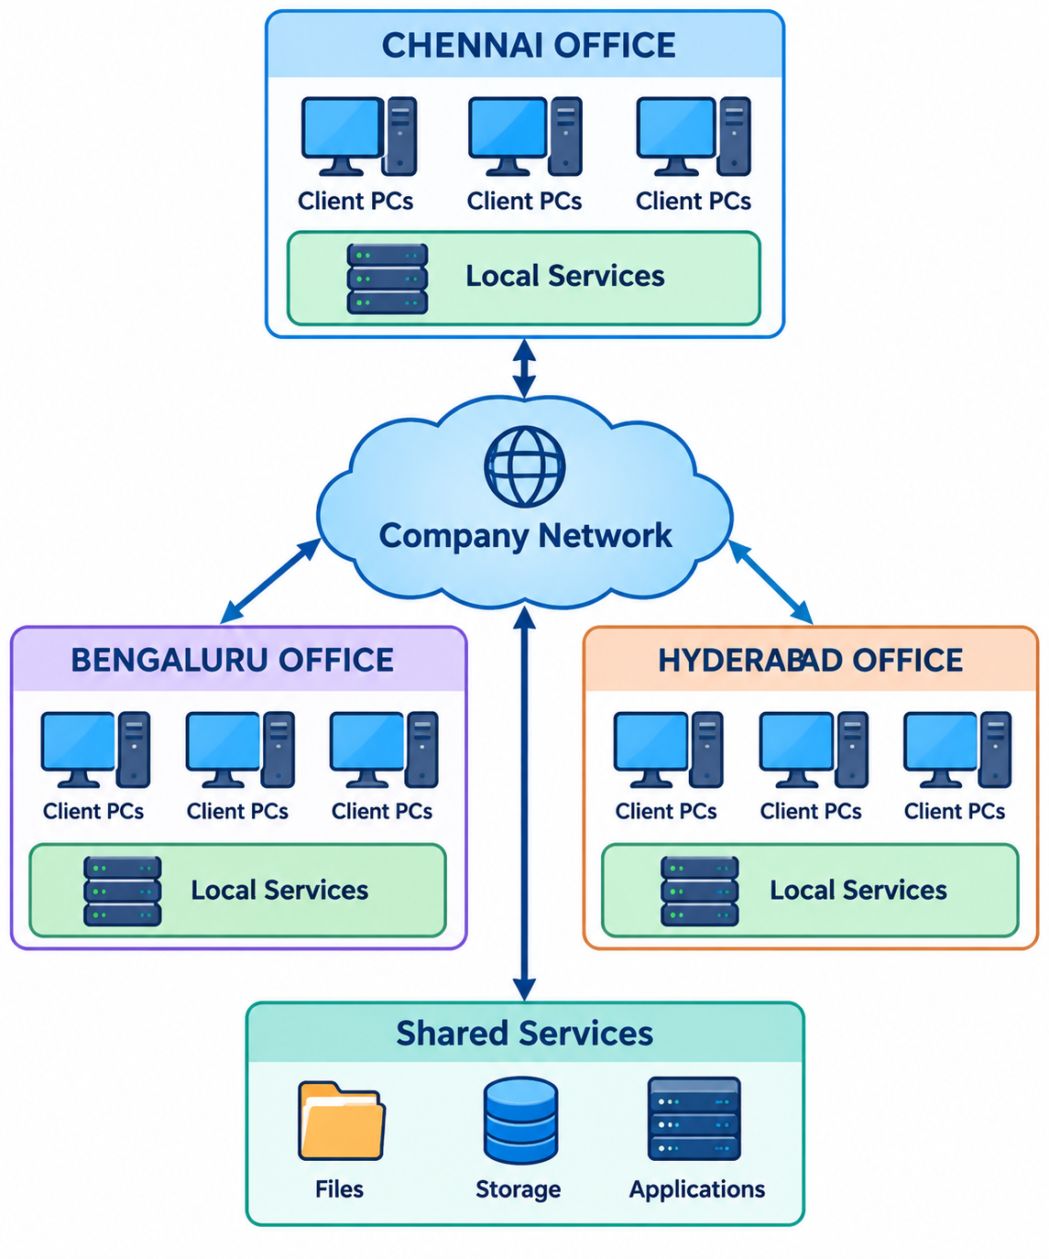
DISTRIBUTED OS ARCHITECTURE

Slide 5
Conclusion
A distributed operating system connects multiple computers to work together.
It enables communication between computers located in different places.
It allows users to share files, applications, and storage resources.
It improves resource utilization and system performance.
It supports multiple users accessing resources simultaneously.
It helps employees collaborate across different company branches.

Slide 6
THANK YOU

